Slide 1

01
FINDING DREAM HOMES THE MARKET MISSED
By Cristian Choco

Slide 2

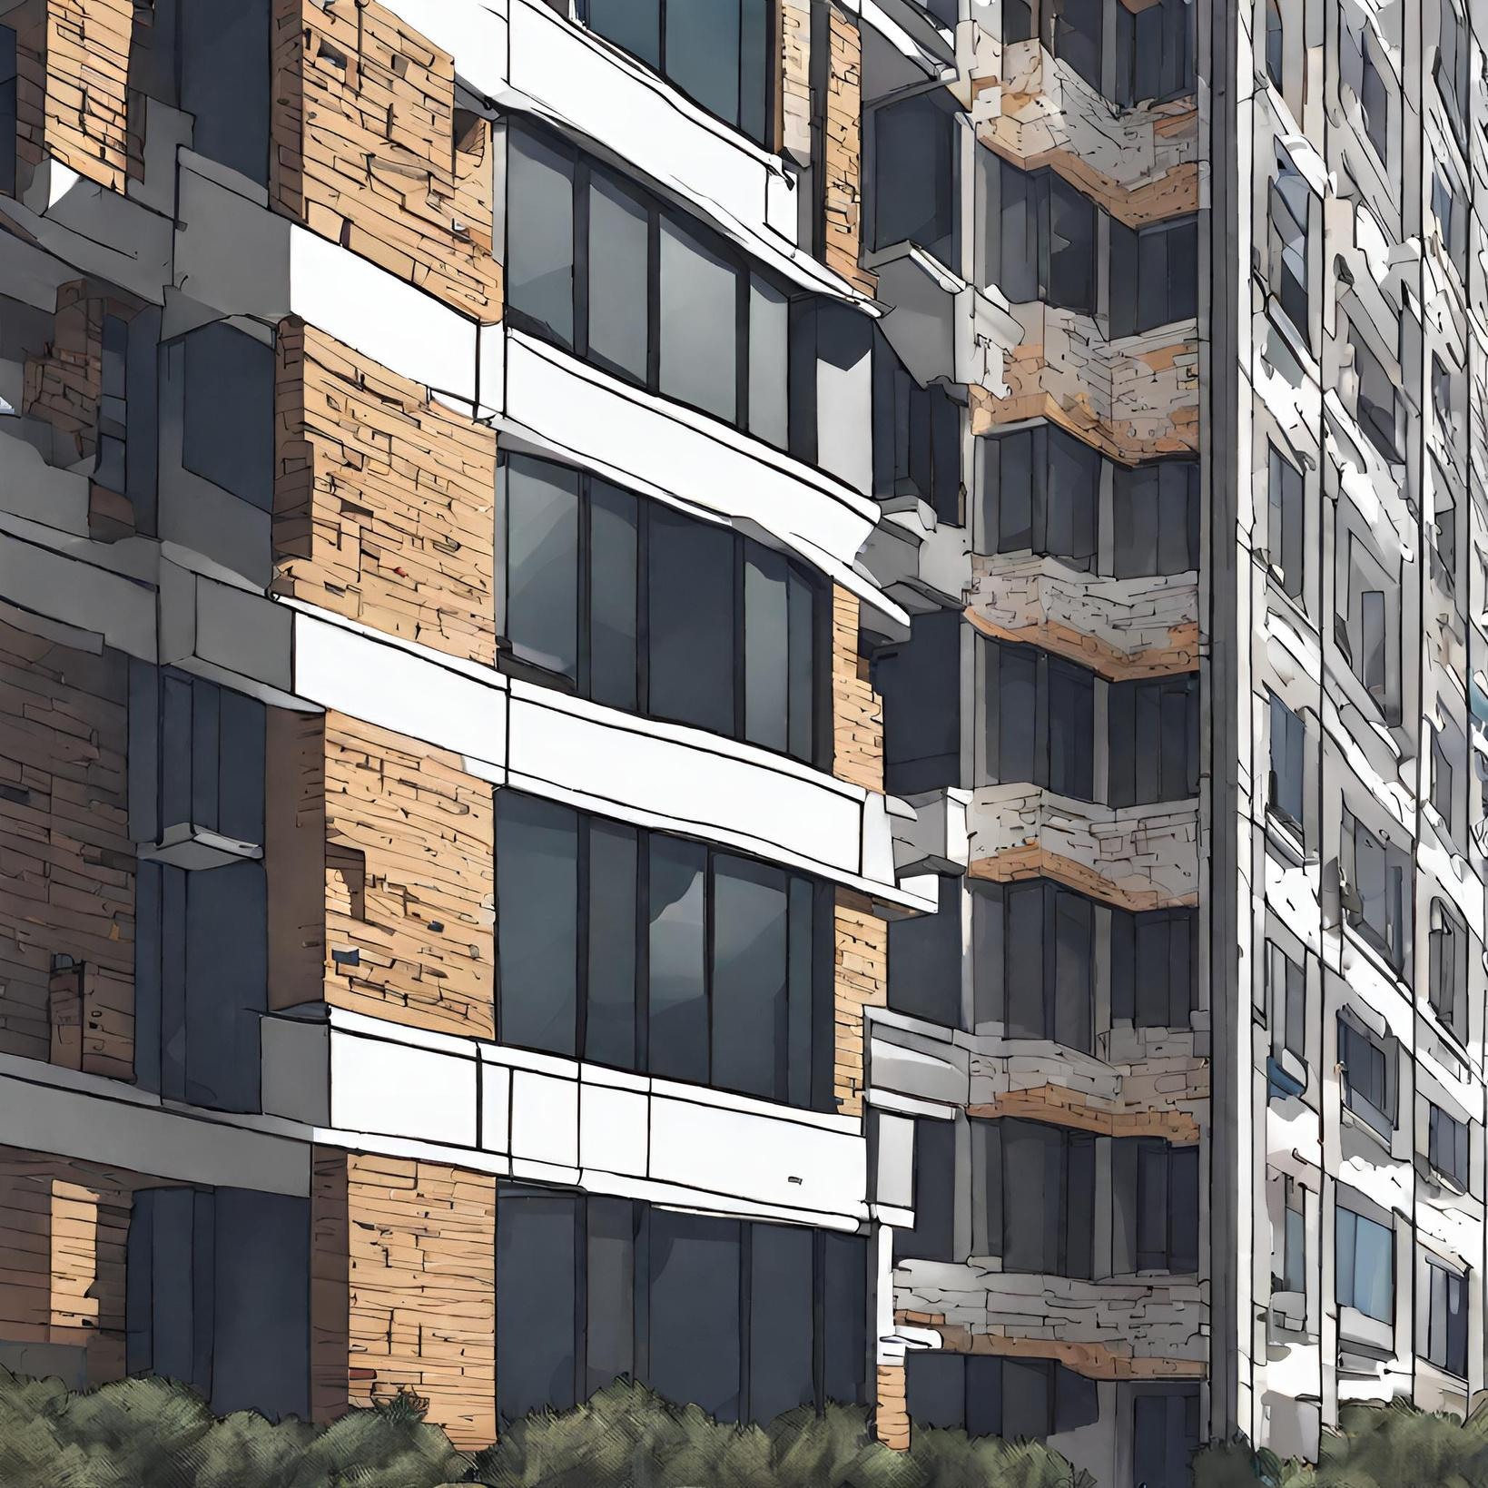

Agenda
1.) Understanding the Basics
2.) Goals
3.) The Identifiers
4.) Main Issues
5.) The Solution
6.) Results

Slide 3
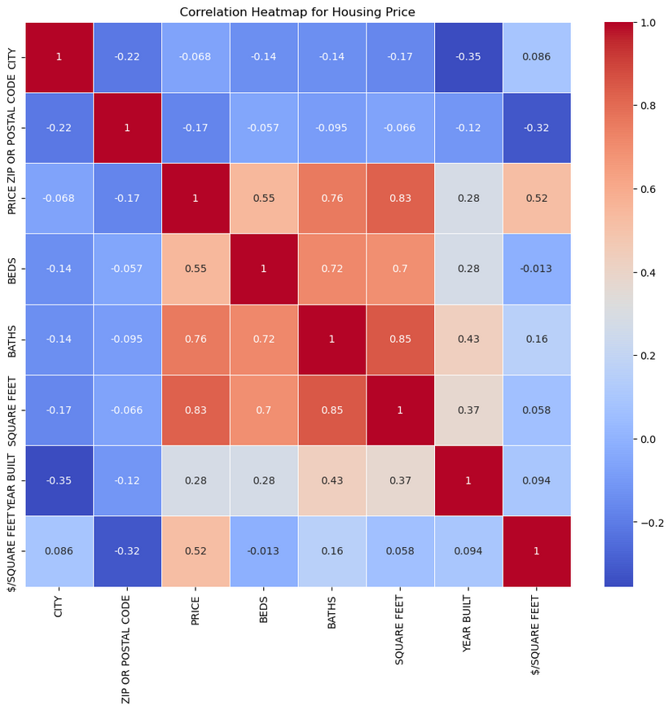
The Basics
Finding your Ideal house
What was the purpose of all this?
What Is the focus of your goal?
Why is value important?
What should you look for?

Slide 4

Identifiers
1
$/SQUARE FEET
2
YEAR BUILT
3
SQUARE FEET
4
BEDS/BATHS
5
ZIP/POSTAL CODE

Slide 5
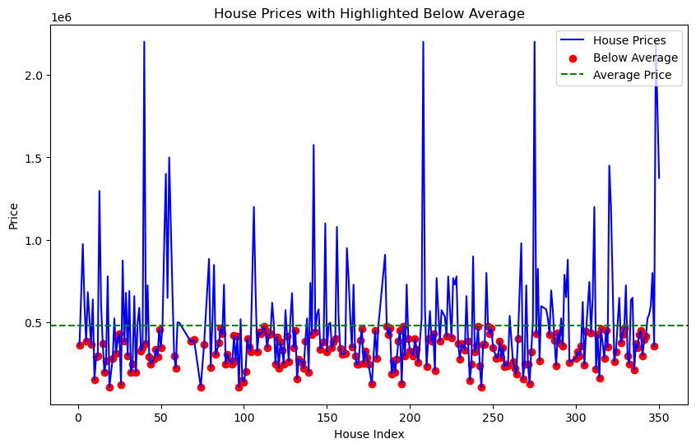
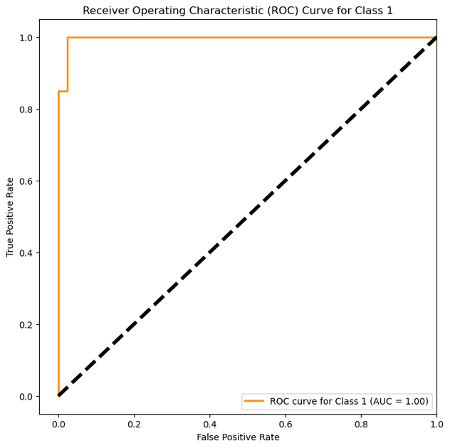
Big Issues
Possible Solution
The average price, is influenced by outliers
What can we do about this?
What does this chart indicate?
We can utilize logistic regression, and other forms of machine learning algorithms
Overall AUC-ROC Score: 0.97

Slide 6
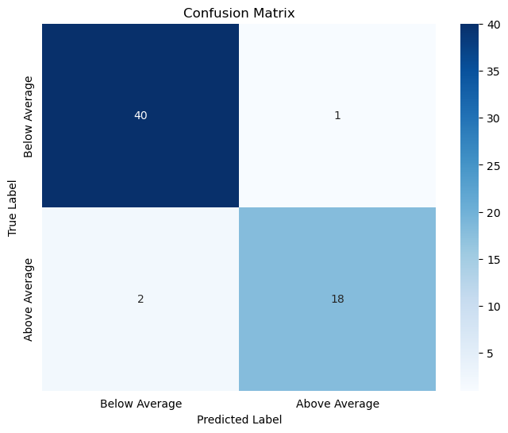
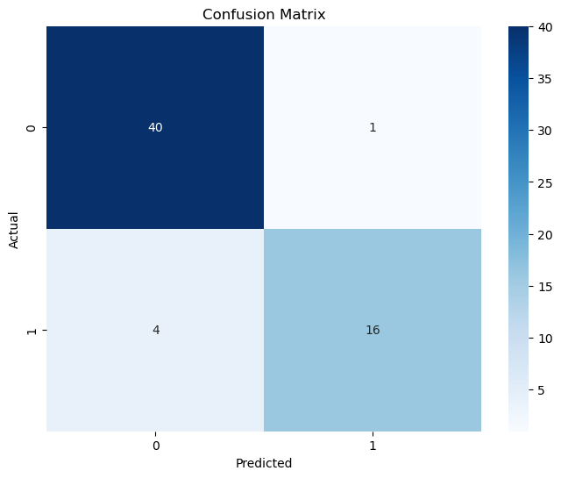
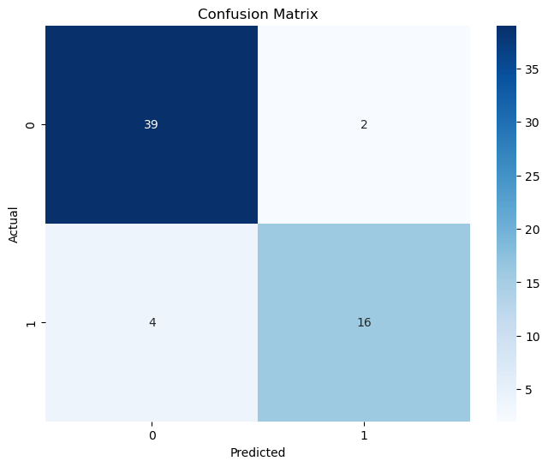
These models indicate that the features that were picked can sustain different interpretations to the Data
Different Classifications:
Classification Error (Misclassification Rate): 0.049
Sensitivity (True Positive Rate or Recall): 0.9
Specificity: 0.97
False Positive Rate: 0.02
What does that mean?
4.9% of the time, your model incorrectly classified a house
Houses that are actually undervalued
Houses that are not undervalued.
Houses that the model incorrectly classifies as undervalued.
LOGISTIC REGRESSION
SVC VECTOR MODEL
NAIVE BAYES
Logistic Regression Accuracy: 0.97
SVC Accuracy: 0.92
Naive Bayes Accuracy: 0.90

Slide 7
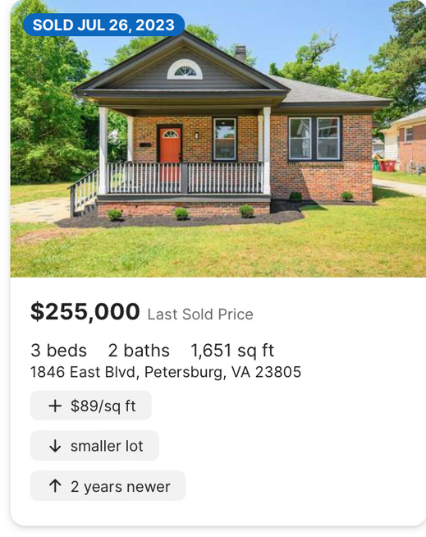
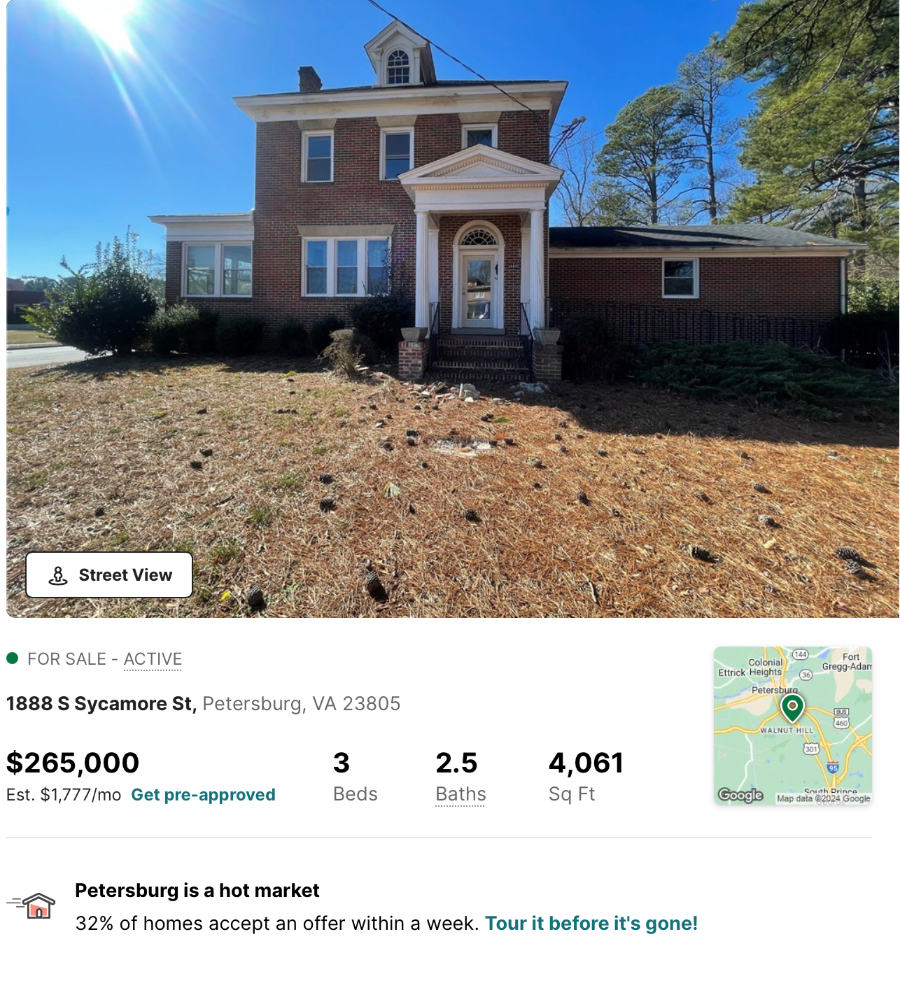
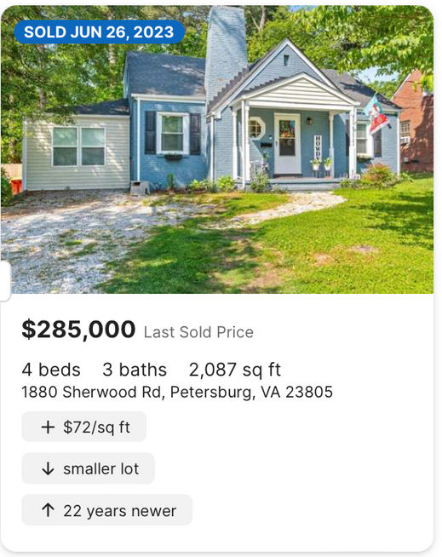
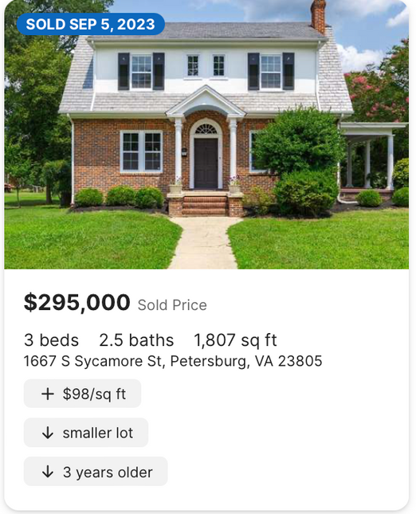
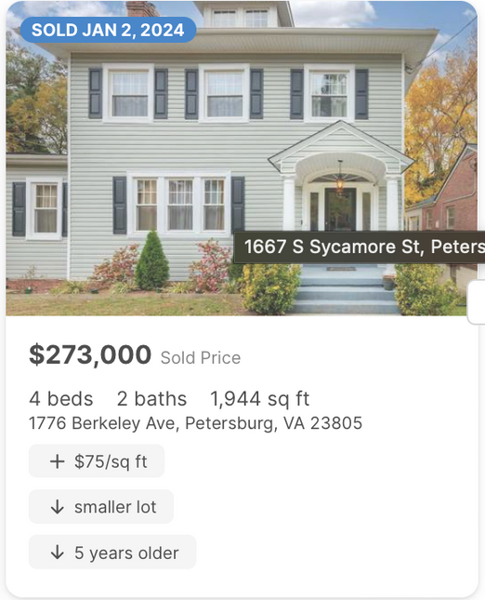

Slide 8

MY CONCLUSION
THE END

